Slide 1
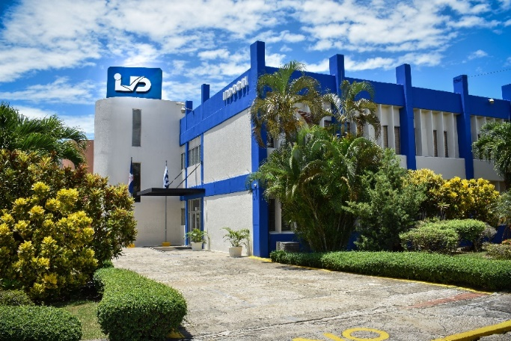
…………………………………………………………………………………………………………………………………………………………………………………………………………………………………………………………………………………………………………………………………………………………………………………………………………………………………………………………………………………………..
Experiences in the Dominican Republic with NORDOM 775 standard. Management System for Gender Equality.
Notes:
1

Slide 2
Initiative that seeks the insertion of women in areas historically reserved for men through the construction of a culture of equality between men and women.

Slide 3
How did the initiative come about?
To support the Sustainable Development Goal (SDG) No. 5 and the national development strategy Law 01-12 that promotes the effective exercise of Human Rights in the sense of equality between men and women and the right to a free life of violence.

Slide 4
GLOBAL COMMUNITY
The distinctive of Gender Equality is a global initiative of the UNPD.
It offers countries action tracking; training; an online platform, INDICA IGUALDAD, for auto diagnosis, progress measurement and opportunities for regional and international experience exchanges.

Slide 5
Standard development process
The work began in February 2015, through the proposal submitted to the National Technical Committee as the basis for discussions promoted by UNDP, the Ministry of Women in alliance with INDOCAL.

Slide 6
Consulted Documents for the creation of NORDOM 775
4. International standards for management and quality systems
1. International Agreements and Conventions (ratified in the Dominican Republic by Congress)
2. Constitution of the Dominican Republic
3. Laws and Decrees of the Dominican Republic

Slide 7
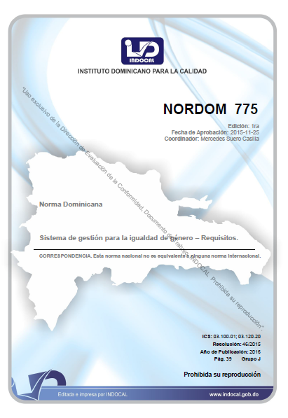
Evolution NORDOM 775
2015
Committee Meetings
2016
Publication
2017
Dissemination, awareness and recruitment of companies for certification (MMujer and UNDP)
2020
5 Yearly Review

Slide 8
Different institutions collaborated in its preparation, such as:

Slide 9
Framework of reference
Manual for the implementation of NORDOM 775 Standard in companies and organizations.
NORDOM 775 Management System for Gender Equality.

Slide 10
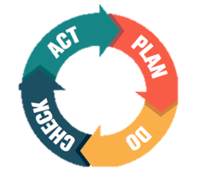
NORDOM 775 General Details
The standard contemplates a Gender Equality Management System (SGIG) that integrates political actions and eliminates gaps between men and women.
Certifiable technical standard of voluntary compliance.
Based on the PDCA cycle (Plan, Do, Check and Act).
It can be applied by public and private institutions of any size.

Slide 11
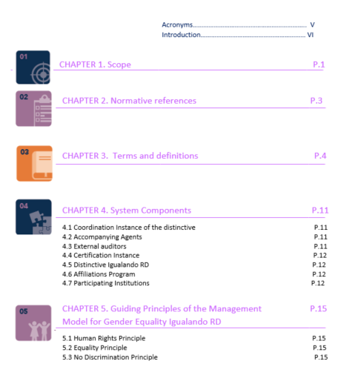
Structure of the Standard

Slide 12
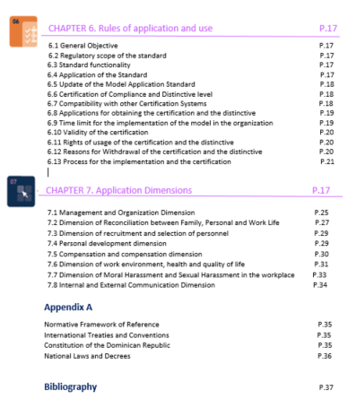
Structure of the Standard

Slide 13
Question:
Do you think that COVID-19 has improved the situation on gender equality issues?

Slide 14
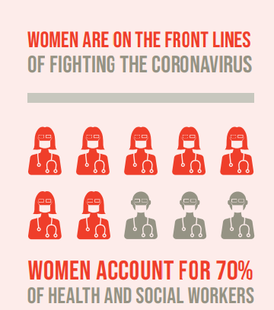

Slide 15
8 Dimensions
1- Management and organization dimension within the company / institution
Signature of commitment letter | Formulate Policies and Principles | Develop code of ethics | Set up a Gender Equality Committee
Appointment of delegate for Gender Equality | Training |  | Continual improvement
COMMITMENT LETTER:
Senior Management Commitment

Slide 16
2- Conciliation and co-responsibility dimension between family, personal and work life
Licenses and Permits related to parenting | Supporting services: Kindergarten Help or subsidies Gift vouchers and / or discounts
Support for homes and vehicles
3- Staff recruitment and selection dimension
Job profiles with a non-exclusive gender perspective | Calls for equitable positions with equal opportunities | Selection of personnel without gender bias

Slide 17
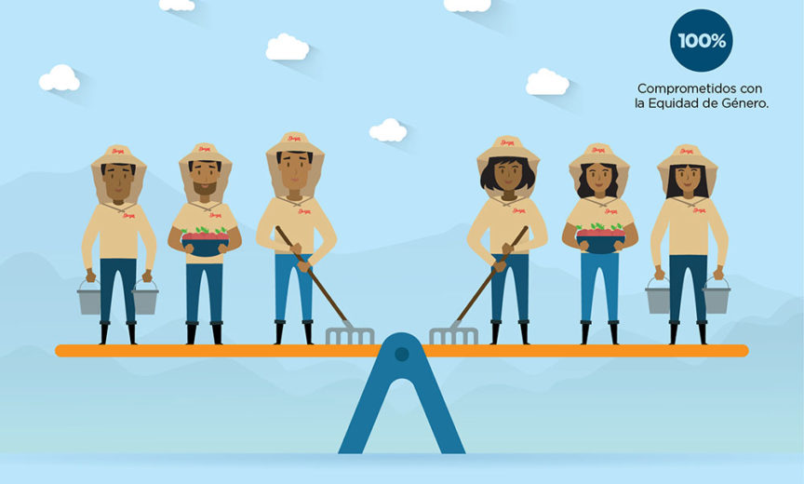
4- Professional development dimension
Professional development career and training plans | Equal access, balanced representation of jobs
5- Remuneration and compensation dimension
Transparent and fair salary structure | Remuneration policy

Slide 18
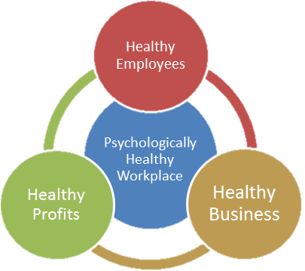
6- Dimension of work environment, health and quality of life.
Healthy work environments are promoted | Adequate infrastructure |  |  | Recreational activities
Prevention and intervention of gender-based domestic violence and workplace harassment |  |  | Safety at work
Health care |  | Community Resources Registry

Slide 19
7- Moral and sexual harassment dimension
Regime of consequences, moral and sexual harassment in the workplace | Effective assistance to victims
8- Internal and external communication dimension
Non sexist language and image | Dissemination of policies and procedures | Corporate image management

Slide 20
Certified Organizations:
No. | ORGANIZATION | DATE | TYPE OF DISTINTIVE | SECTOR
1 | BEPENSA DOMINICANA | JANUARY 2018 | GOLD | PRODUCER
2 | BHD LEON | JANUARY 2018 | GOLD | BANKING
3 | HUMANO SEGUROS | SEPTEMBER 2018 | GOLD | INSURANCE CARRIER
4 | GRUPO UNIVERSAL | JANUARY 2020 | GOLD | INSURANCE CARRIER
5 | CLARO DOMINICANA | MARCH 2019 | GOLD | TELEPHONE SERVICES
6 | BARRICK PUEBLO VIEJO | APRIL 2020 | GOLD | MINING
7 | EGE HAINA | AUGUST 2020 | GOLD | ELECTRICAL

Slide 21
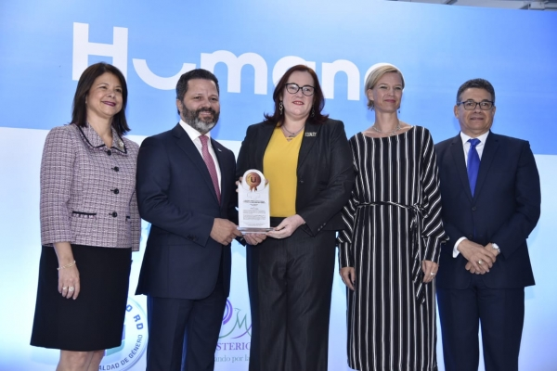
Certified Organizations

Slide 22
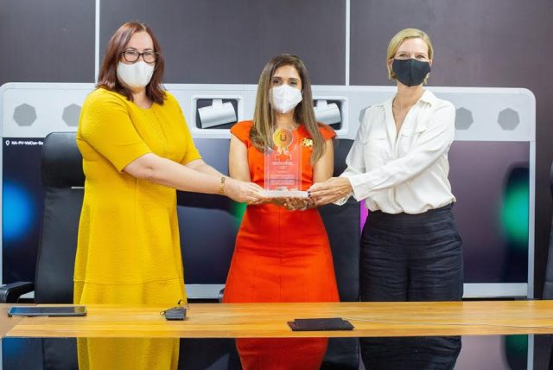
Certified Organizations

Slide 23
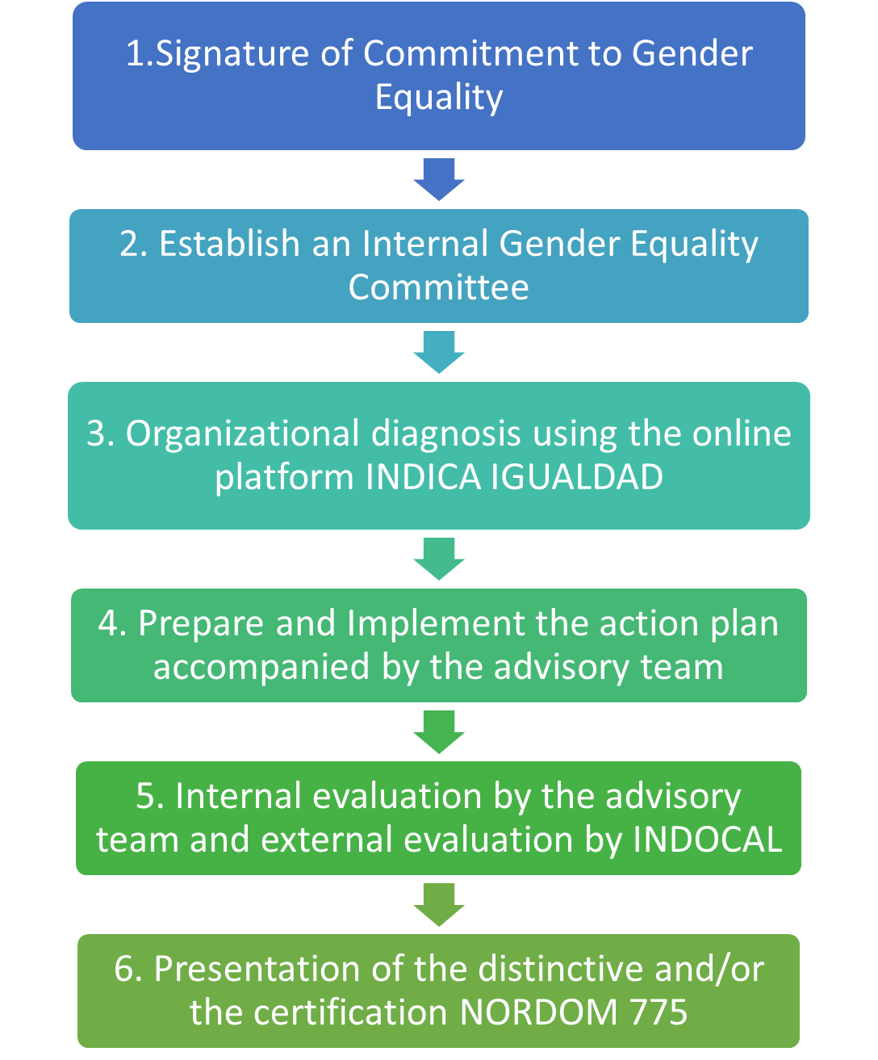
Steps to obtain
Commitment and preparation
Policy evaluation and establishment
Third party certification and obtaining the distinctive

Slide 24
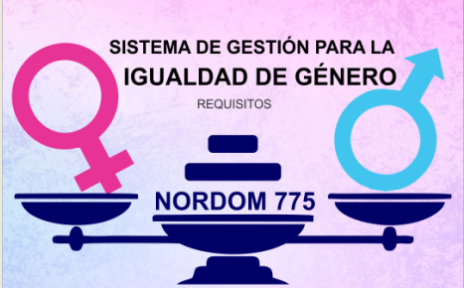
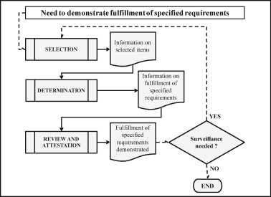
Process of Certification
Organizations work on the general guidelines of the standard, assume the commitments and implement all the requirements established in the eight dimensions.
They make the request and the certification body develops the activities of the functional conformity assessment scheme.
The validity of the certification is 3 years with 2 annual follow-up audits.

Slide 25
Impacts
Improves work environment (reduces absenteeism, increases productivity and greater staff commitment).
Adds social value (generates economic and social gains, improves the positive image of the organization and contributes to a competitive advantage in the market).
Contributes to the economy by increasing the Gross Domestic Product (GDP), according to studies by the International Monetary Fund (IMF), by 34%

Slide 26
Organizations that have implemented the requirements of NORDOM 775 and have successfully completed the certification process obtain the corresponding distintive.

Slide 27
Implementation and training
Third party Certification
+ other certification bodies acredited

Slide 28
Certification and distintive levels
Instituto Dominicano para la Calidad
When the organization has reached a compliance level of 60% of the requirements.
Bronze Distintive
Silver Distintive
When the organization has reached a compliance level of 70% of the requirements.
Gold Distintive
When the organization has reached a compliance level of 80% of the requirements.
Platinum Distintive
When the organization has reached a Gold
level for two consecutive periods.

